Slide 1
IT305 Computer Networks Week 13_Lec3 Switched Ethernet

Slide 2

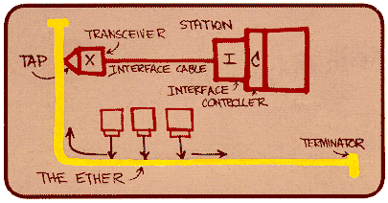
Ethernet
“dominant” wired LAN technology:
first widely used LAN technology
simpler, cheaper than token LANs and ATM
kept up with speed race: 10 Mbps – 10 Gbps
Metcalfe’s Ethernet sketch
Link Layer
5-2
Notes:
2

Slide 3
Ethernet frame structure
sending adapter encapsulates IP datagram (or other network layer protocol packet) in Ethernet frame
preamble:
7 bytes with pattern 10101010 followed by one byte with pattern 10101011
used to synchronize receiver, sender
addresses:
6 byte source, destination MAC addresses
type: indicates higher layer protocol – IPv4 or v6
CRC: cyclic redundancy check at receiver
error detected: frame is dropped
type
preamble
dest.
address
source
address
data (payload)
CRC

Slide 4
802.3 Ethernet standards: link & physical layers
many different Ethernet standards
common MAC protocol and frame format
different speeds: 2 Mbps, 10 Mbps, 100 Mbps, 1Gbps, 10G bps
different physical layer media: fiber, cable
application
transport
network
link
physical
MAC protocol
and frame format
100BASE-TX
100BASE-T2
100BASE-FX
100BASE-T4
100BASE-SX
100BASE-BX
copper (twister
pair) physical layer
fiber physical layer
Link Layer
5-4
Notes:
4

Slide 5
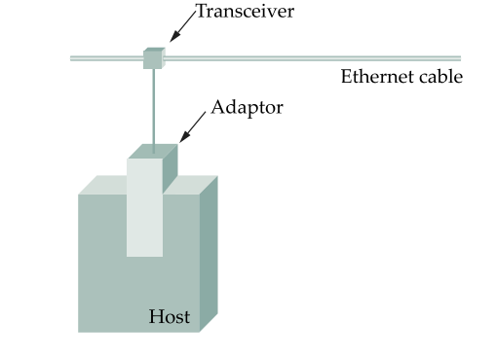
Ethernet Segments
Ethernet segment cable size 500 m
Hosts connect to segment by tapping which has a transceiver (Tx, Rx)
Network adapter in the device (NIC) connects to the transceiver
Mulitple NICs can be connect across the 500 m cable with tap points being 2.5 apart (Standards)
Ethernet protocol implemented in the NIC
Multiple segments joined through repeaters
Max 4 segments = 2000m
Max 1024 hosts
Repeaters:
forward digital signals
Multiport repeater is a Hub

Slide 6
Classic Ethernet
Stations on single shared bus
Collisions if no proper protocol
Ethernet –CSMA
Carrier Sense Multiple Access –CD
Exponential back-off
Collisions reduced

Slide 7
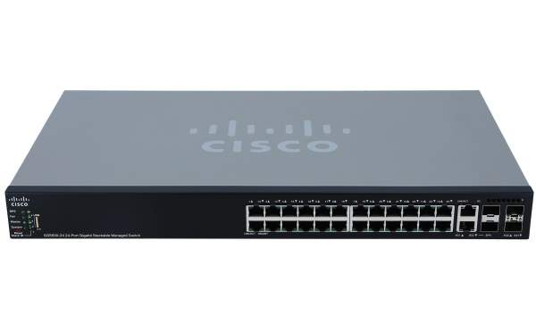
Architectural change
Switched ethernet

Slide 8
Ethernet switch
link-layer device: takes an active role
store, forward Ethernet frames
examine incoming frame’s MAC address, selectively forward frame to one-or-more outgoing links when frame is to be forwarded on segment, uses CSMA/CD to access segment
transparent
hosts are unaware of presence of switches
plug-and-play, self-learning
switches do not need to be configured

Slide 9



Switch: multiple simultaneous transmissions
hosts have dedicated, direct connection to switch
switches buffer packets
Ethernet protocol used on each incoming link, but no collisions; full duplex
each link is its own collision domain
switching: A-to-A’ and B-to-B’ can transmit simultaneously, without collisions
A
C’
B
6
1
2
5
4
3
B’
C
A’
switch with six interfaces
(1,2,3,4,5,6)

Slide 10
Switch: frame filtering/forwarding
when frame received at switch:
1. record incoming link, MAC address of sending host
2. index switch table using MAC destination address
3. if entry found for destination then {
if destination on segment from which frame arrived then drop frame –BROADCASTED ALREADY
else forward frame on interface indicated by entry
}
else flood /* forward on all interfaces except arriving
interface */
But how des the switch get this forwarding interface information? i.e,
how does it know which device is conenected to which interface?

Slide 11
Switch forwarding table
Q: how does switch know A’ reachable via interface 4, B’ reachable via interface 5?
A
C’
B
A: each switch has a switch table, each entry:
(MAC address of host, interface to reach host, time stamp)
looks like a routing table!
6
1
2
5
4
3
B’
C
A’
Q: how are entries created, maintained in switch table?
something like a routing protocol?
switch with six interfaces
(1,2,3,4,5,6)

Slide 12
Switch: self-learning
Source: A
Dest: A’
switch learns which hosts can be reached through which interfaces
when frame received, switch “learns” location of sender: incoming LAN segment
records sender/location pair in switch table
A
A A’
C’
B
6
1
2
5
4
3
B’
C
A’
MAC addr interface TTL
A
1
60
Switch table
(initially empty)

Slide 13
Self-learning, forwarding: example
Source: A
Dest: A’
A
A A’
frame destination, A’, locaton unknown:
flood
C’
B
destination A location known:
6
1
2
A A’
A A’
A A’
A A’
selectively send
on just one link
A A’
5
4
3
B’
C
A’ A
A’
MAC addr interface TTL
A
1
60
switch table
(initially empty)
A’
4
60

Slide 14

Interconnecting switches
switches can be connected together
S₄
S₁
S₃
A
S₂
F
I
B
C
D
E
G
H
Q: sending from A to G - how does S₁ know to forward frame destined to F via S₄ and S₃?
A: self learning! (works exactly the same as in single-switch case!)

Slide 15
Self-learning multi-switch example
Suppose C sends frame to I, I responds to C
S₄
S₁
S₃
A
S₂
F
I
B
C
D
E
G
H
Q: show switch tables and packet forwarding in S₁, S₂, S₃, S₄

Slide 16
Synthesis: a day in the life of a web request
our journey down the protocol stack is now complete!
application, transport, network, link
putting-it-all-together: synthesis!
goal: identify, review, understand protocols (at all layers) involved in seemingly simple scenario: requesting www page
scenario: student attaches laptop to campus network, requests/receives www.google.com

Slide 17
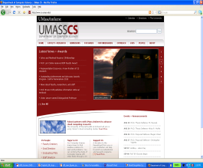



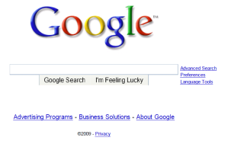
A day in the life: scenario
scenario:
DNS server
arriving mobile client attaches to network …
browser
Comcast network
68.80.0.0/13
requests web page: www.google.com
school network
68.80.2.0/24
web page
Sounds
simple!
web server
Google’s network
64.233.160.0/19
64.233.169.105

Slide 18
A day in the life: connecting to the Internet
DHCP
DHCP
UDP
IP
Eth
Phy
connecting laptop needs to get its own IP address, addr of first-hop router, addr of DNS server: use DHCP
DHCP
DHCP
DHCP
arriving mobile:
DHCP client
DHCP
DHCP request encapsulated in UDP, encapsulated in IP, encapsulated in 802.3 Ethernet
DHCP
DHCP
UDP
IP
Eth
Phy
DHCP
DHCP
DHCP
DHCP
Ethernet frame broadcast (dest: FFFFFFFFFFFF) on LAN, received at router running DHCP server
router has
DHCP server
Ethernet de-muxed to IP de-muxed, UDP de-muxed to DHCP

Slide 19

A day in the life: connecting to the Internet
DHCP
UDP
IP
Eth
Phy
DHCP server formulates DHCP ACK containing client’s IP address, IP address of first-hop router for client, name & IP address of DNS server
DHCP
DHCP
DHCP
arriving mobile:
DHCP client
DHCP
encapsulation at DHCP server, frame forwarded (switch learning) through LAN, demultiplexing at client
DHCP
DHCP
UDP
IP
Eth
Phy
DHCP
DHCP
DHCP
DHCP
router has
DHCP server
DHCP client receives DHCP ACK reply
Client now has IP address, knows name & addr of DNS
server, IP address of its first-hop router

Slide 20
A day in the life… ARP (before DNS, before HTTP)
DNS
DNS
UDP
IP
Eth
Phy
before sending HTTP request, need IP address of www.google.com: DNS
DNS
DNS
ARP
ARP query
arriving mobile:
ARP client
DNS query created, encapsulated in UDP, encapsulated in IP, encapsulated in Eth. To send frame to router, need MAC address of router interface: ARP
ARP
ARP query broadcast, received by router, which replies with ARP reply giving MAC address of router interface
ARP reply
Eth
Phy
router has
ARP server
client now knows MAC address of first hop router, so can now send frame containing DNS query

Slide 21
A day in the life… using DNS
DNS
DNS
DNS
DNS
DNS
DNS
UDP
IP
Eth
Phy
de-muxed to DNS
DNS replies to client with IP address of www.google.com
DNS
DNS
UDP
IP
Eth
Phy
DNS
DNS
DNS
DNS
DNS
DNS
server
DNS
DNS
Comcast network
68.80.0.0/13
IP datagram containing DNS query forwarded via LAN switch from client to 1st hop router
IP datagram forwarded from campus network into Comcast network, routed (tables created by RIP, OSPF, IS-IS and/or BGP routing protocols) to DNS server

Slide 22
A day in the life…TCP connection carrying HTTP
DNS
DNS
DNS
HTTP
HTTP
TCP
IP
Eth
Phy
to send HTTP request, client first opens TCP socket to web server
SYNACK
SYN
SYNACK
SYN
SYNACK
SYN
SYN
Comcast network
68.80.0.0/13
TCP SYN segment (step 1 in TCP 3-way handshake) inter-domain routed to web server
TCP
IP
Eth
Phy
web server responds with TCP SYNACK (step 2 in TCP 3-way handshake)
SYNACK
SYN
SYNACK
SYN
SYNACK
SYNACK
SYN
TCP connection established!
Google web server
64.233.169.105

Slide 23
A day in the life… HTTP request/reply
DNS
DNS
DNS
HTTP
HTTP
TCP
IP
Eth
Phy
HTTP request sent into TCP socket
HTTP
HTTP
HTTP
web page finally (!!!) displayed
HTTP
HTTP
HTTP
HTTP
HTTP
IP datagram containing HTTP request routed to www.google.com
Comcast network
68.80.0.0/13
web server responds with HTTP reply (containing web page)
HTTP
HTTP
TCP
IP
Eth
Phy
HTTP
HTTP
HTTP
HTTP
IP datagram containing HTTP reply routed back to client
Google web server
64.233.169.105

